Slide 1
Traditional Methodologies
Exploring objectives, processes, advantages, and drawbacks of key methods.

Slide 2
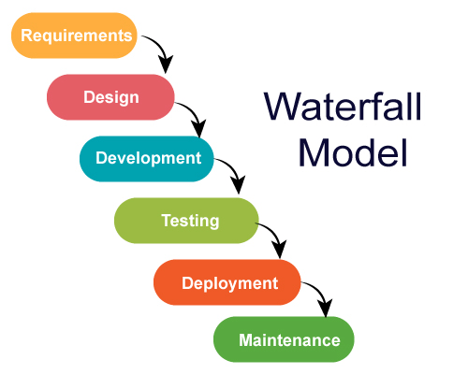
01
Waterfall Methodology

Slide 3
Objective and Process
The Waterfall Methodology is a structured project management approach that emphasizes sequential task completion, suitable for well-defined projects.
Advantages:The Waterfall Methodology provides a clear structure and documentation, facilitating easy management and progress tracking for fixed-requirement projects.
Drawbacks:
1.inflexibility; any change in requirements can disrupt the entire process.
2. long timelines before receiving feedback, as testing only occurs after development.
3. risk of not meeting user needs if the initial requirements are poorly defined.

Slide 4
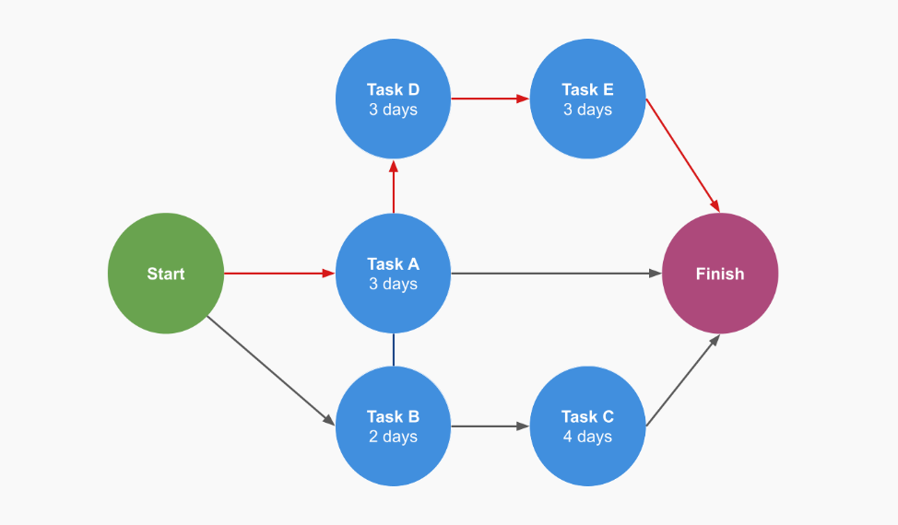
02
Critical Path Method

Slide 5
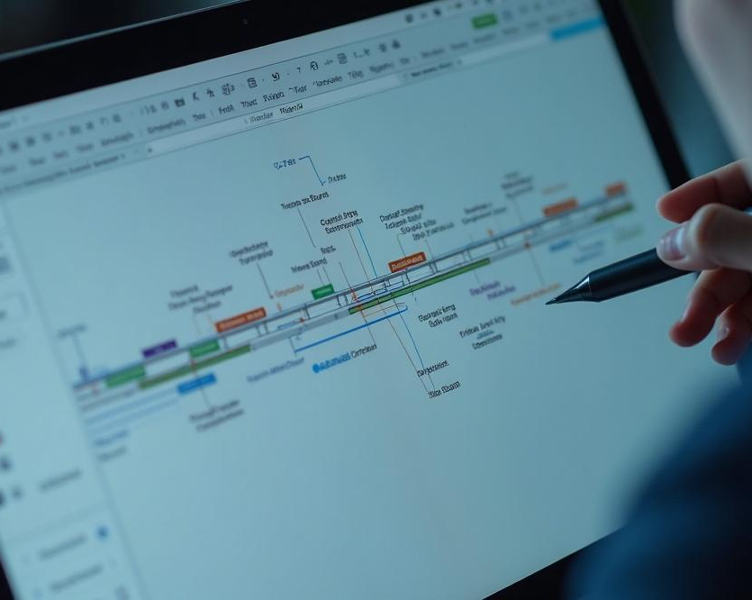
Objective and Process
The Critical Path Method (CPM) is a project management technique that identifies the longest sequence of dependent tasks, determining the minimum project duration. It helps pinpoint crucial activities that cannot be delayed without impacting the overall timeline.
Advantages:CPM offers clear visualization of task dependencies and deadlines, enabling project managers to prioritize critical tasks and allocate resources effectively. It also helps identify potential bottlenecks early, aiding in the maintenance of project schedules.
Drawbacks: 1. assumption that task duration is predictable.
2. It also requires extensive planning and analysis, which can be time-consuming.
3.CPM may overlook resource constraints like staff availability, leading to unrealistic scheduling.

Slide 6
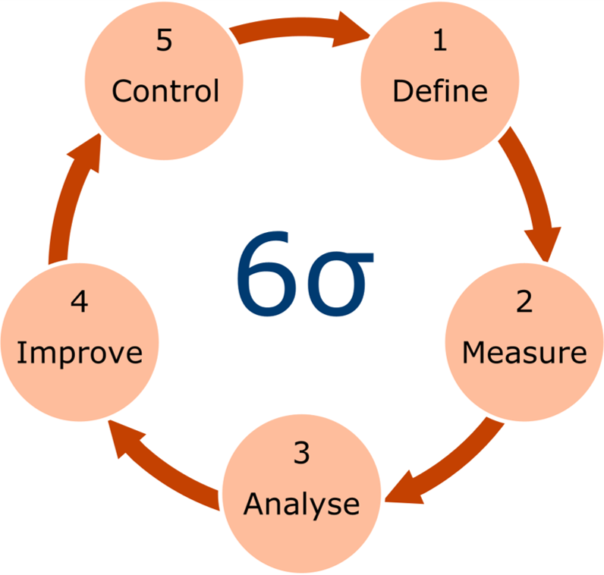
03
Six Sigma

Slide 7

Objective and Process
Six Sigma is a data-driven methodology focused on process improvement by reducing defects and variations to enhance quality and efficiency. It follows the DMAIC framework—Define, Measure, Analyze, Improve, and Control—for systematic improvement through data analysis and control measures.
Advantages: Six Sigma emphasizes quality and customer satisfaction, providing tools to identify root causes of defects for efficient process improvement. This enhanced performance can lead to cost reductions and increased customer loyalty, positively affecting the bottom line.
Drawbacks: 1. can be complicated and take a lot of time, requiring significant training and resources, and employees may resist changes to their usual processes.
2.Focusing too much on numbers can cause important project management aspects to be ignored.

